Slide 1
Samples
Time point Treatment | 2w | 4w | 10w | 12w
Veh (Sham-control) | 8 | 8 | 8 | 8
Scl | 8 |  | 8
PTH |  | 8 |  | 8
PTH: parathyroid hormone treatment
Scl: sclerostin treatment
Veh: control
Different expression analysis
pydeseq2
Sequencing raw data (.fq)
mm39
Alignment (.bam)
Pathway Enrichment
Pathfind.R
Gene count table
Venn

Slide 2
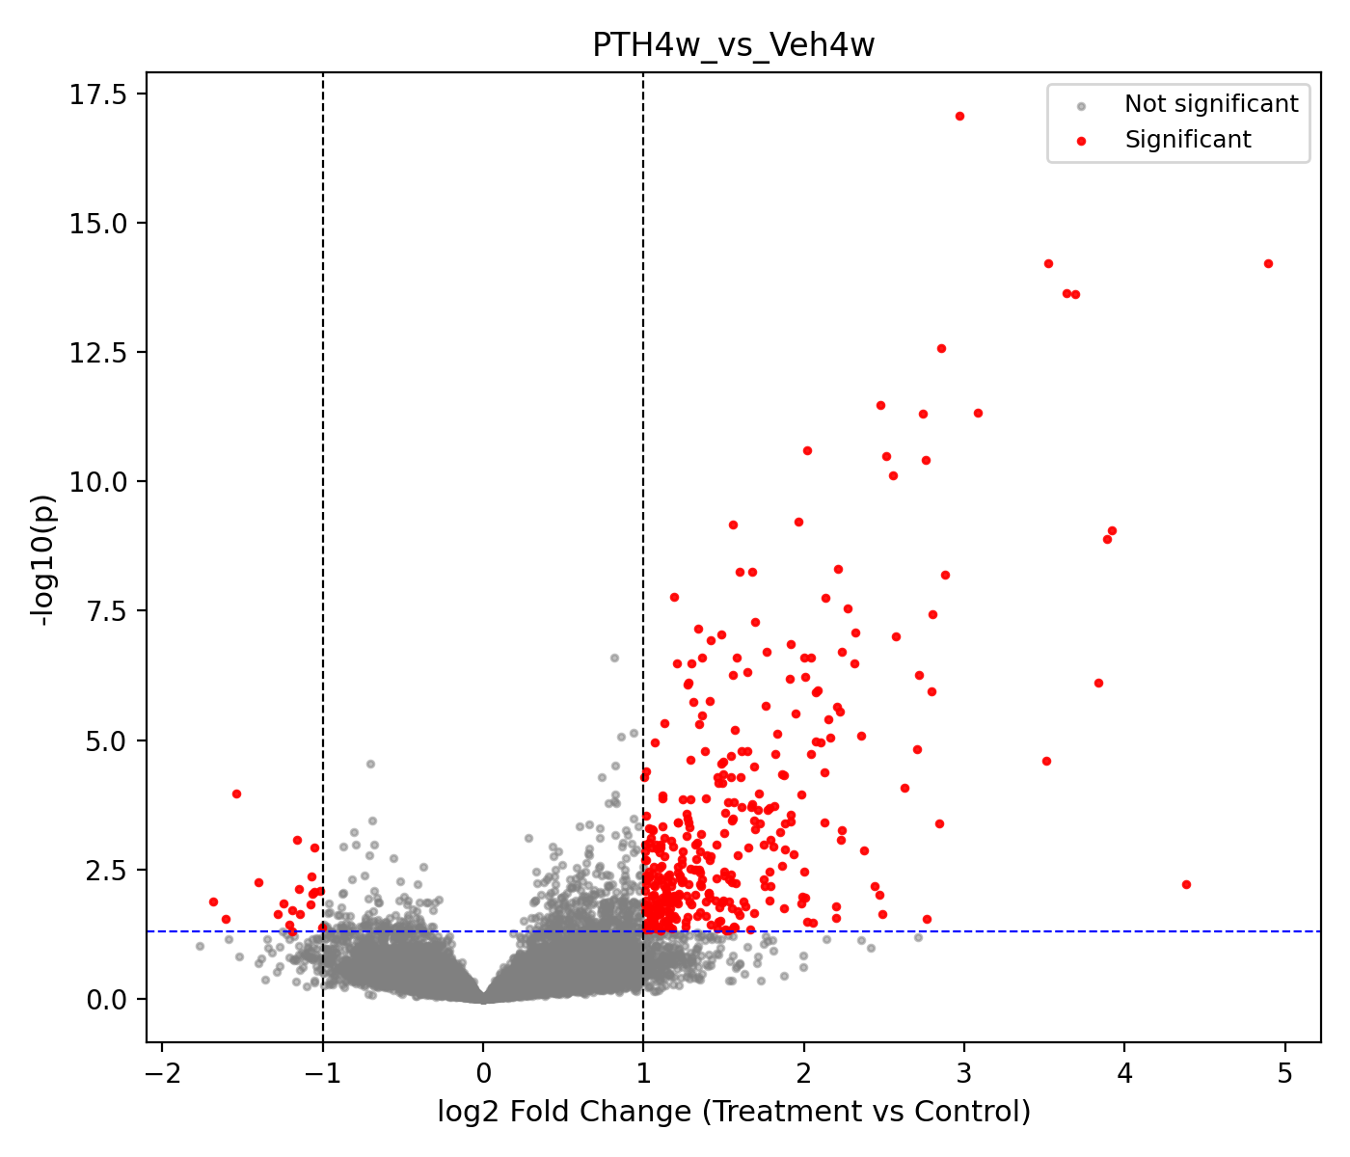
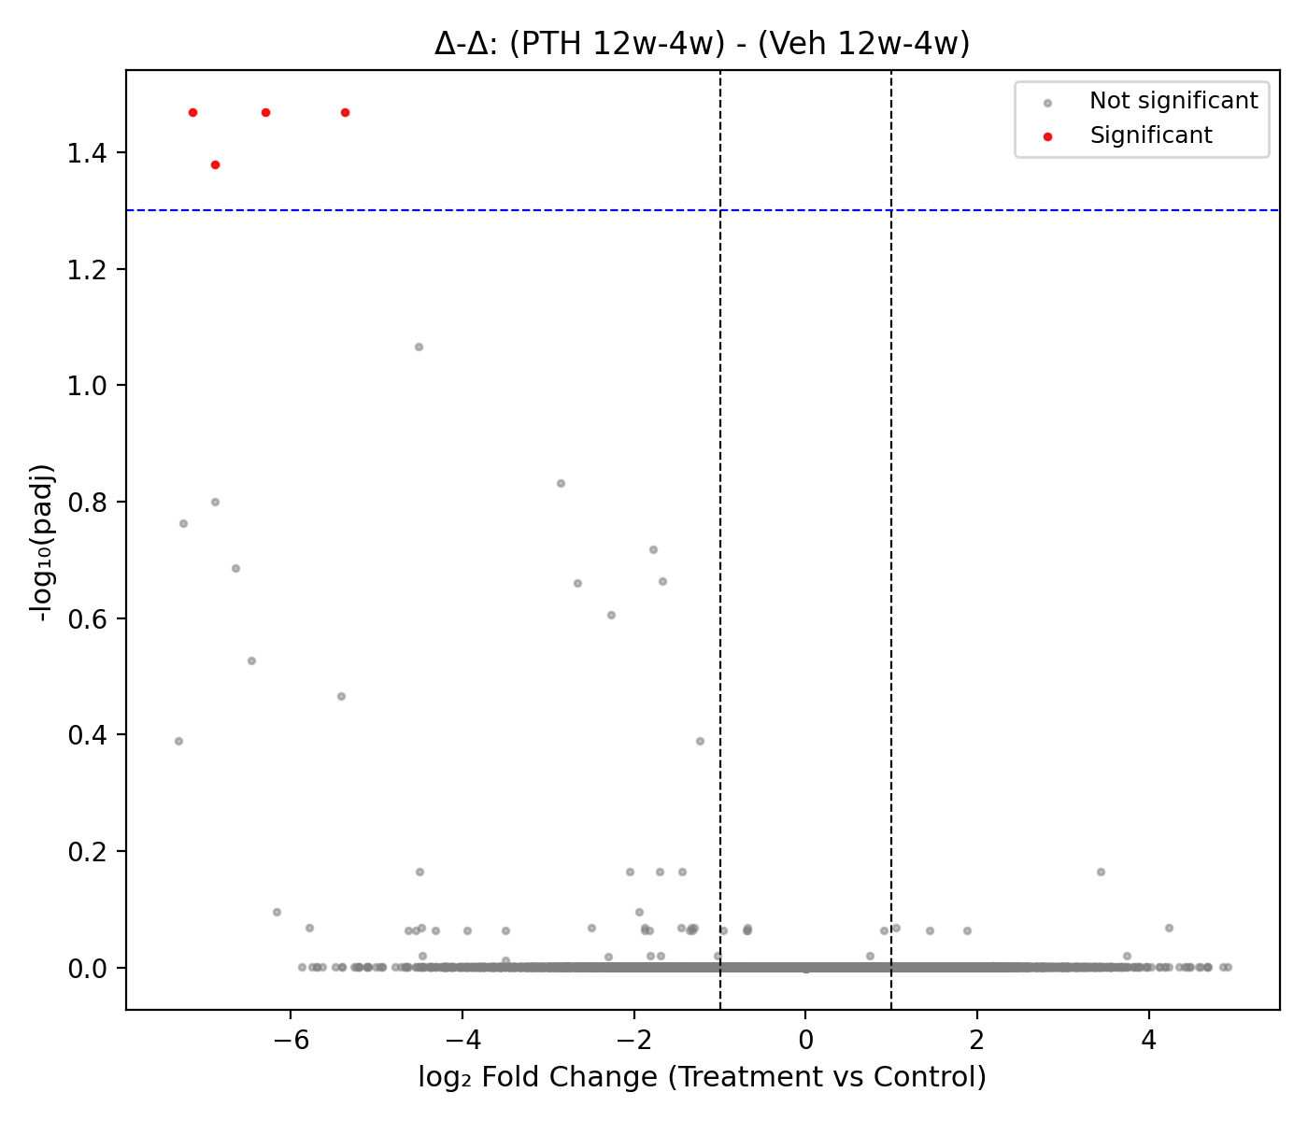
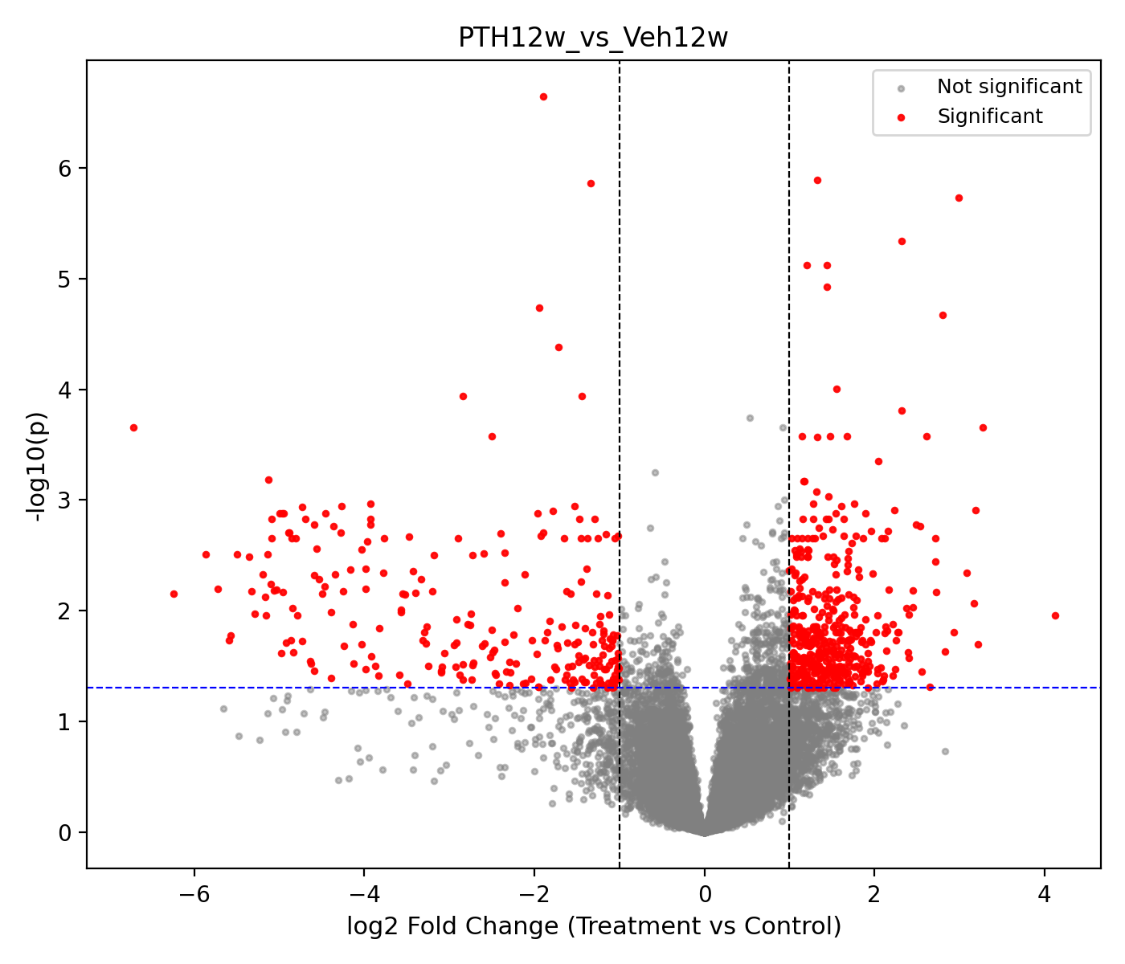
PTH vs Veh
Early stage
late stage
(LogPTH12w – Log PTH4w) – (Log Veh10w – Log Veh2w)
From pyDESeq2 interaction model
Notes:
Box plot for significant genes (double delta) at different time point at treatment/control group

Slide 3
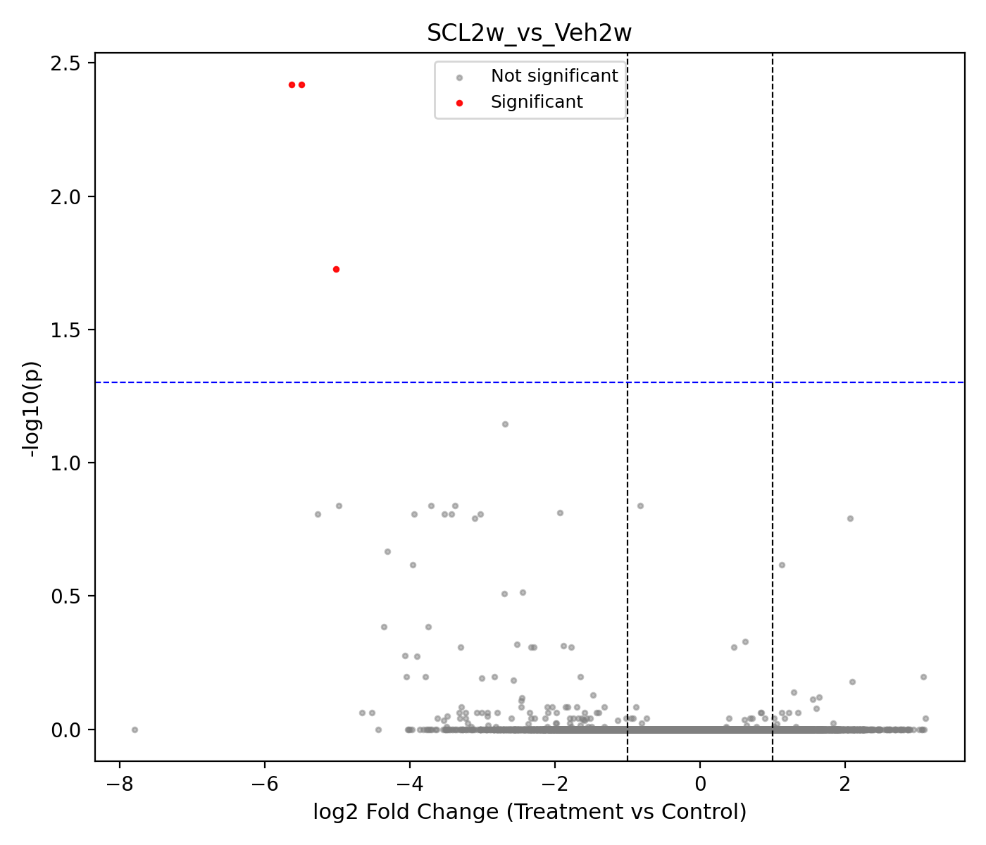
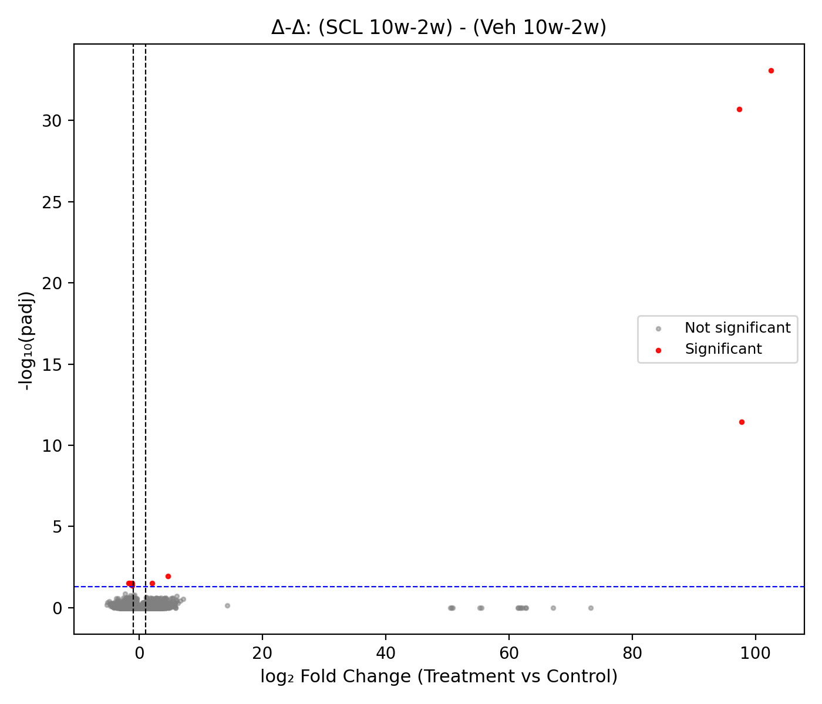
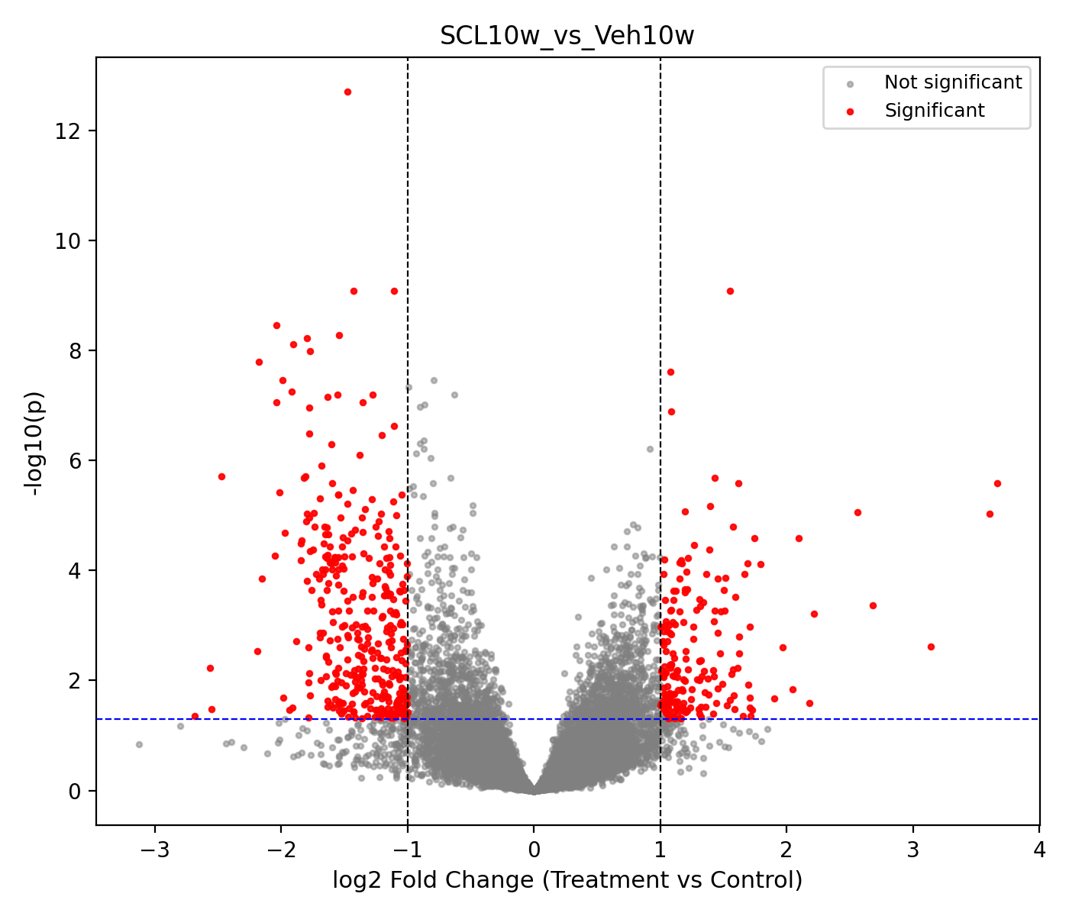
Scl vs Veh
Early stage
Only 3 significant genes, skip for pathway enrichment analysis
late stage
(LogScl10w – Log Scl2w) – (Log Veh10w – Log Veh2w)
From DESeq2 interaction model
Notes:
Box plot for significant genes (double delta) at different time point at treatment/control group

Slide 4
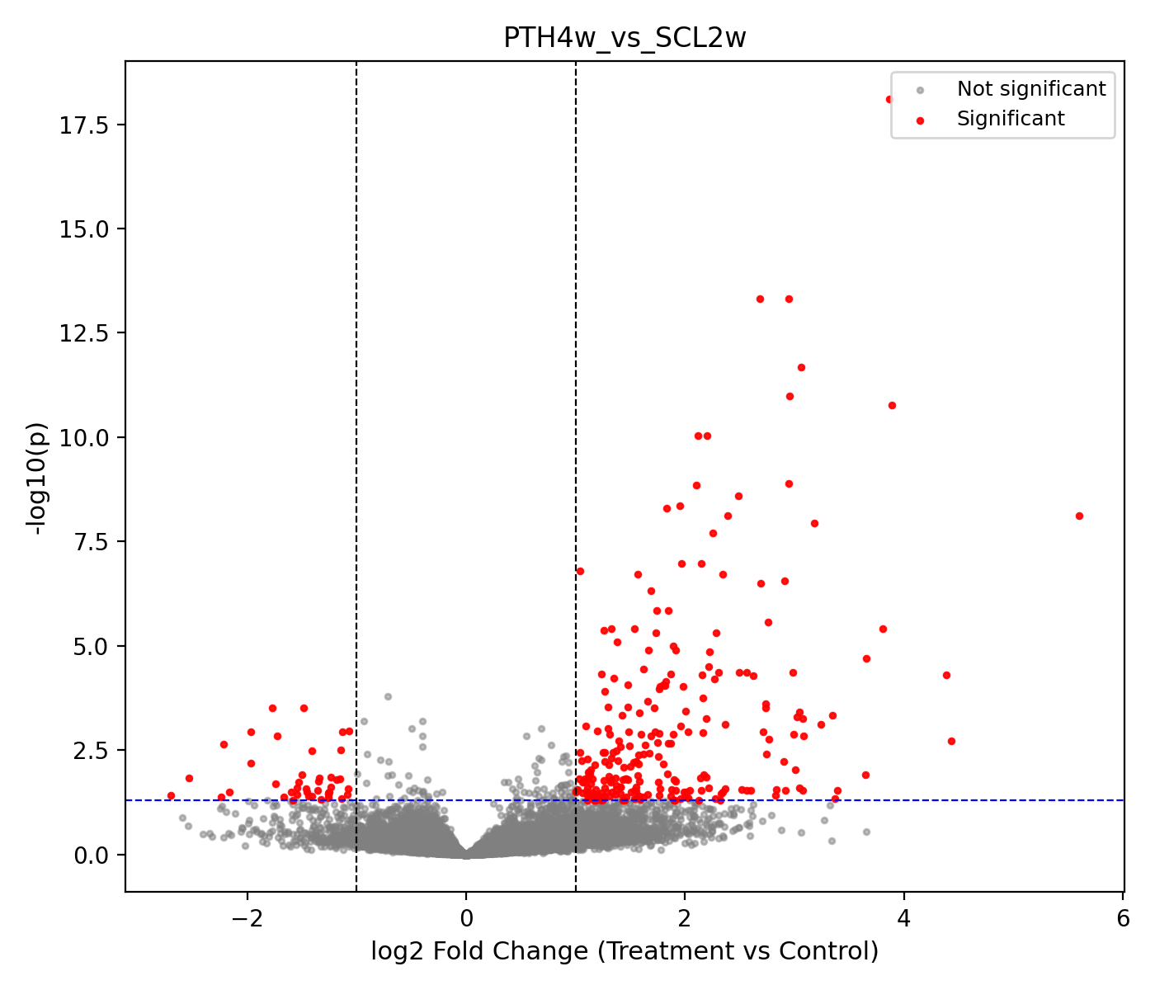
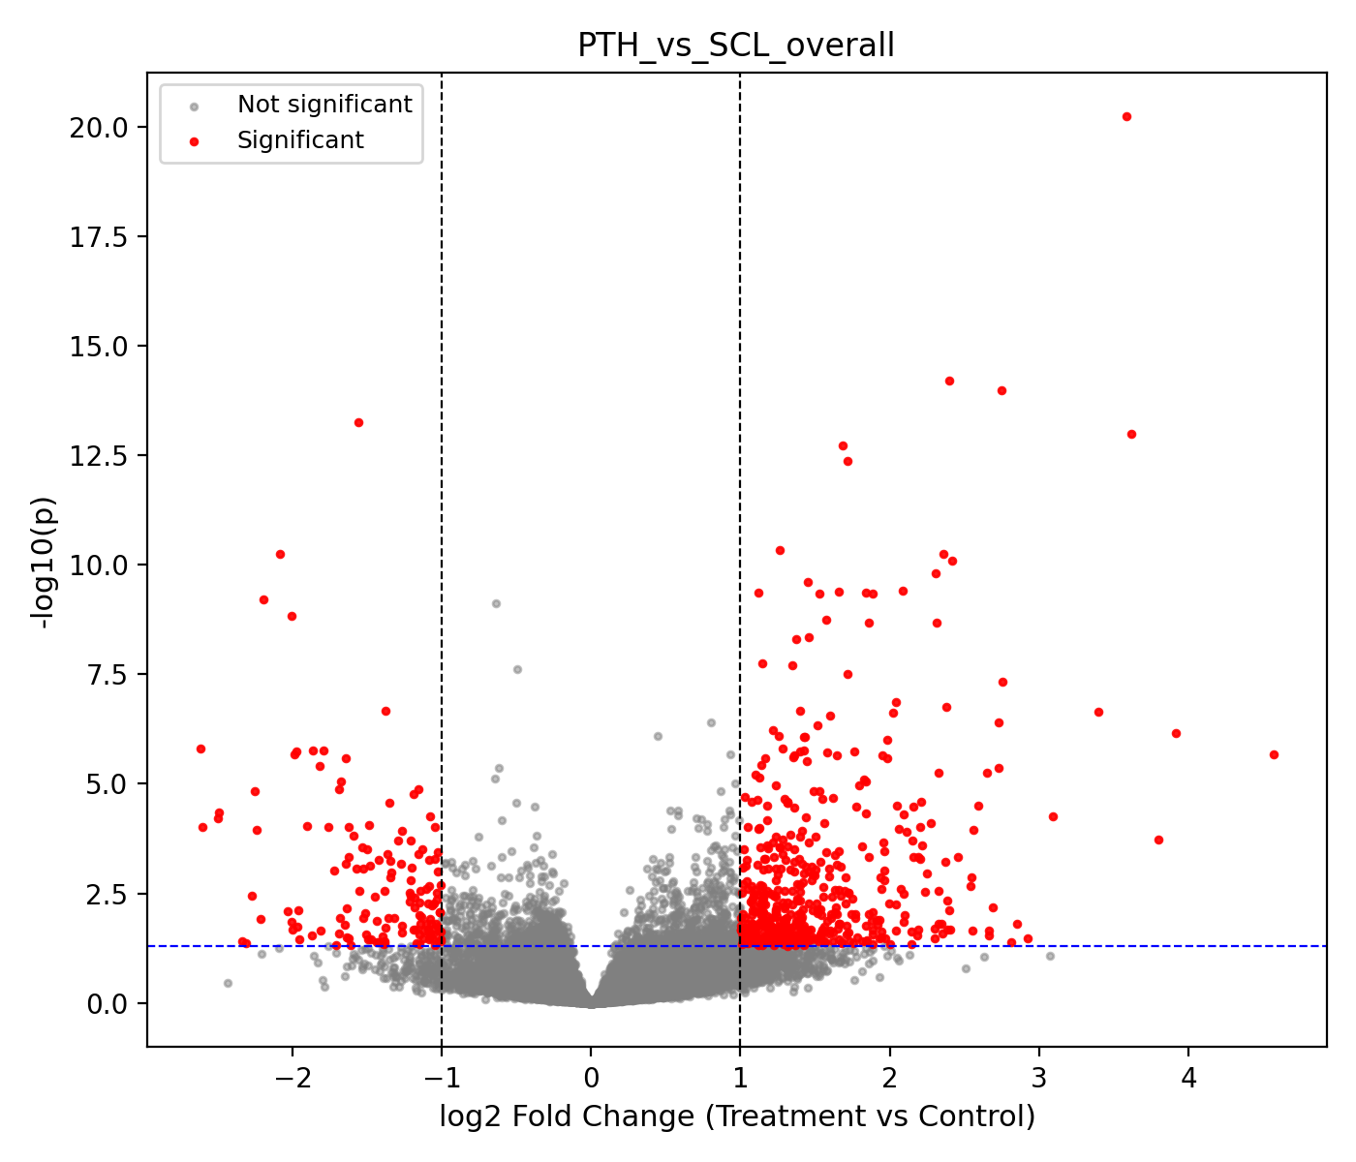
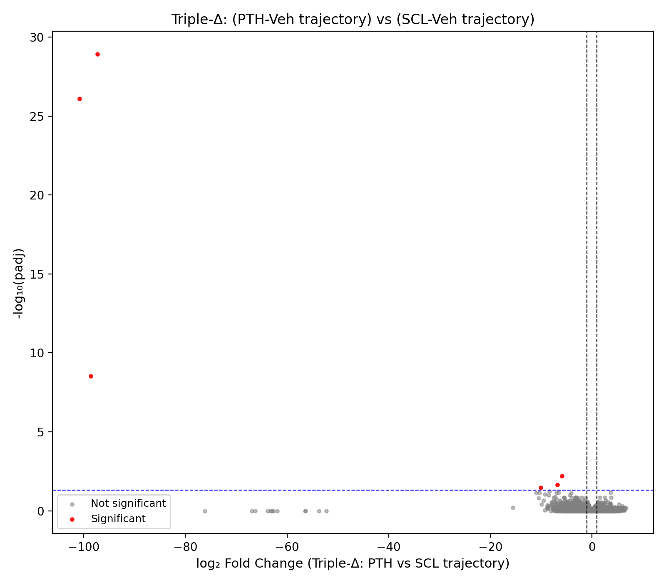
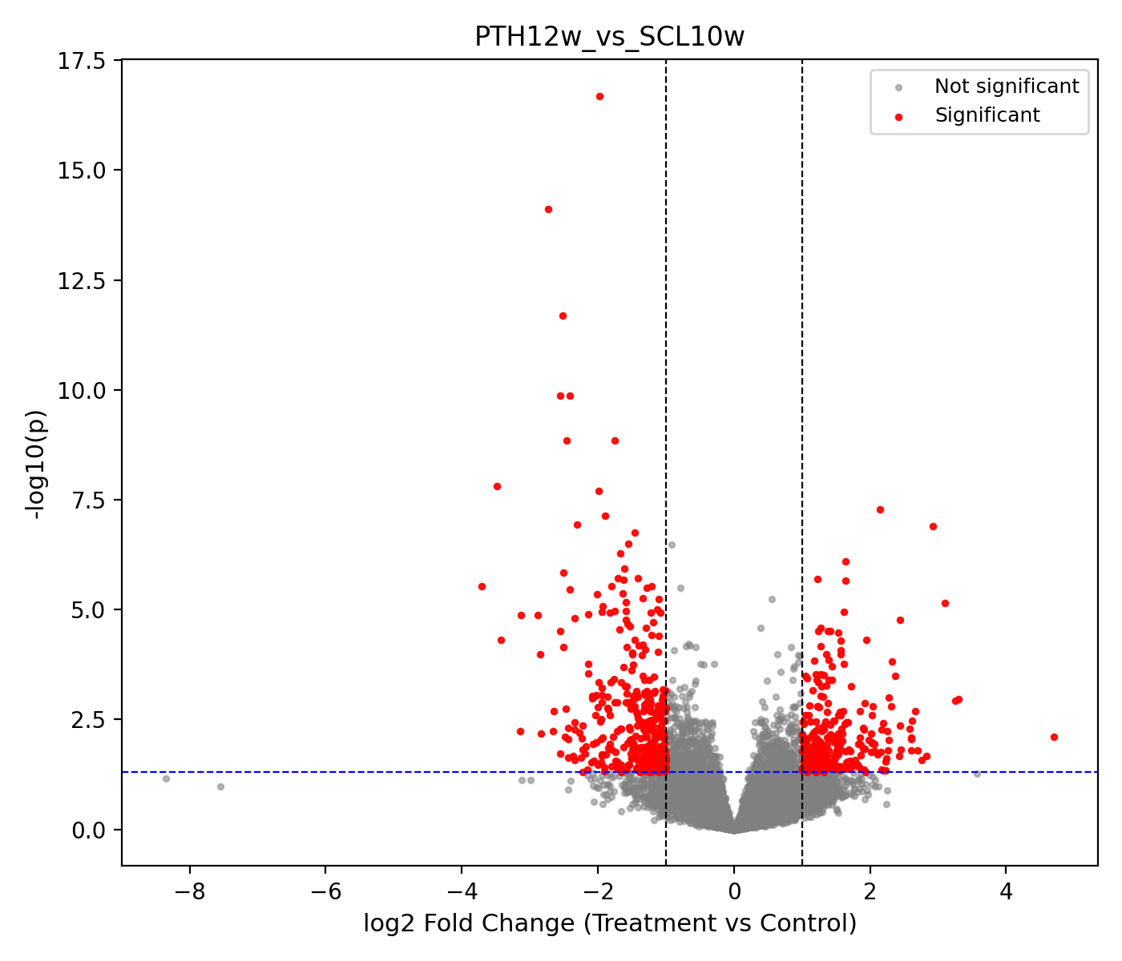
PTH vs Scl
Early stage
(Log mean(PTH all sample)) – (Log mean (Scl all sample))
(LogPTH12w – Log PTH4w) – (Log Scl10w – Log Scl2w)
Warning: This may not be a good compare method!!
late stage
Notes:
Box plot for significant genes (double delta) at different time point at treatment/control group
Box plot for significant genes (triple delta) at different time point at treatment/control group

Slide 5
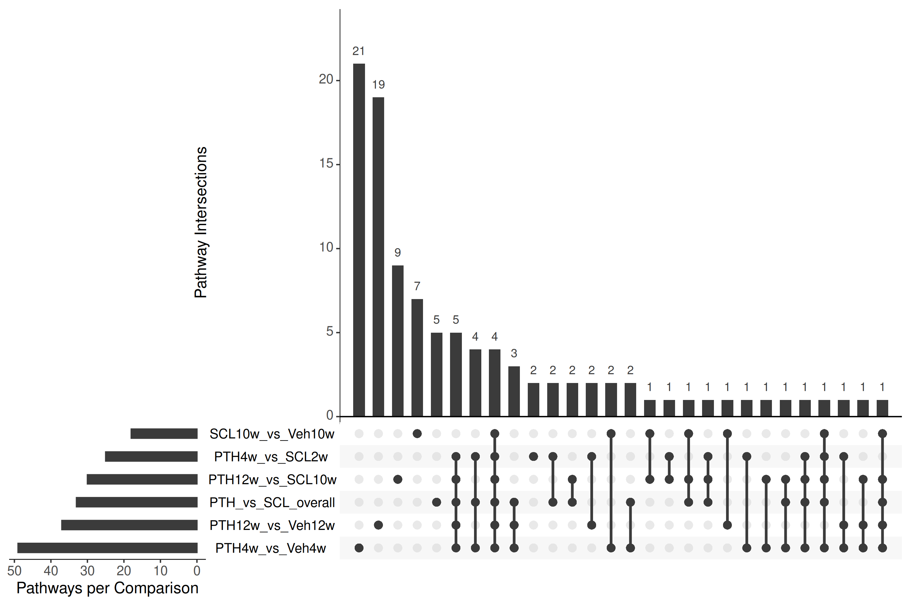
Pathways venn analysis

Slide 6
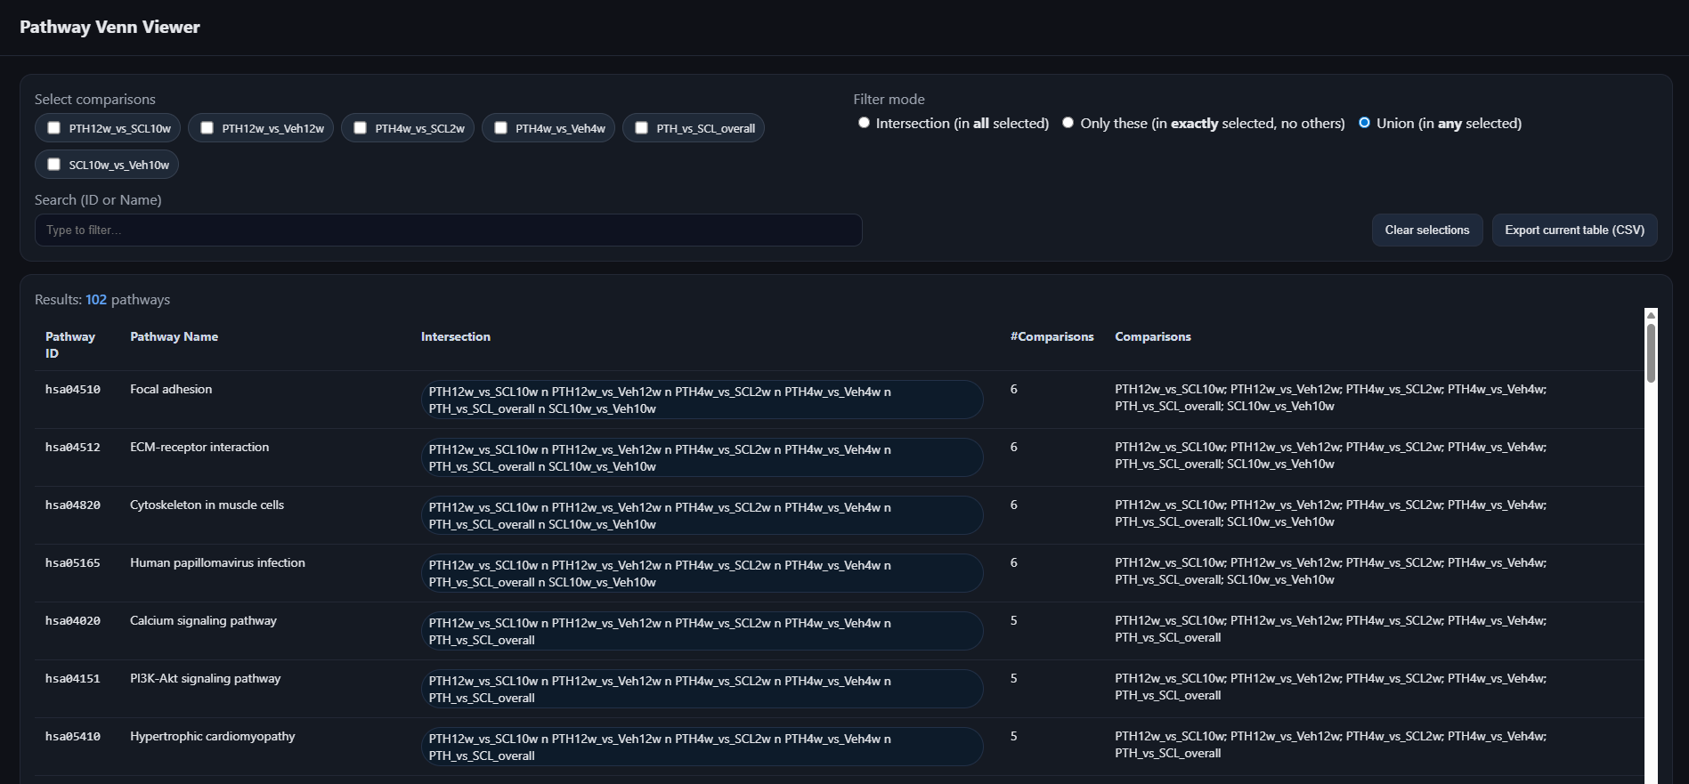
Pathways venn viewer (.html)
Notes:
Put html to my/team Github

